Slide 1
Use graphic organisers to embed writing skills development in TVET
This resource supports the development of level 1, stage 3 design capabilities

Slide 2
Contents
Introduction
What are graphic organisers?
The benefits of using graphic organisers
Ways to use graphic organisers
Concept maps
Mind maps
Venn diagrams
Fishbone diagrams

Slide 3
Introduction
This resource follows a three-step approach to embedding foundation skills in TVET teaching and learning.
Know the demands: examine the standard to find the foundation skills needed.
Know the learners: use diagnostic assessment to find learners’ existing skills.
Know what to do.
This resource supports you to develop tools to use in Step 3.
Graphic organisers are a useful way to represent ideas.
You can adapt these activities to your context, based on the course demands and your learners’ needs.
They might spark some other ideas for you to try.
If you’re not sure about any aspect of these, it can be useful to talk this through with an experienced trainer.

Slide 4
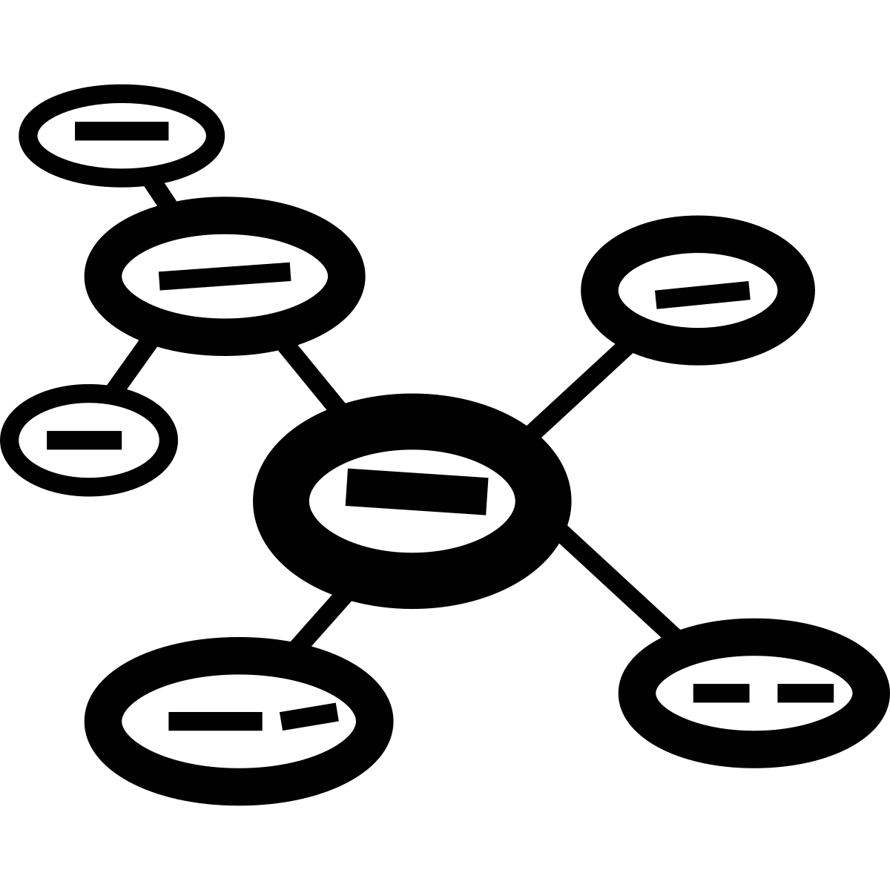
What are graphic organisers?
Graphic organisers help learners arrange their ideas visually before writing.
They break down complex information into manageable parts.
Encourage learners to explore connections between key concepts and terms.
Useful for planning and structuring written work, enhancing clarity and coherence.
We will look at four types:
Mind maps
Concept maps
Venn diagrams
Fishbone diagrams

Slide 5
The benefits of using graphic organisers
Benefits for learners
Benefits for trainers
For learners this can be a useful way to:
write key words and build vocabulary
become familiar with new content
organise ideas
see the bigger picture alongside more detail
brainstorm ideas
work from single words and move toward sentences.
For trainers, this is a useful way to:
spark learners’ creativity and innovation
find out learners’ current knowledge on the subject
develop a visual representation of the subject
show the relationships between different topics.

Slide 6
Ways to use graphic organisers
Use graphic organisers as you work through the new materials or to explore a case study/scenario.
Work together on a whiteboard, in small groups with large paper, or in pairs.
Encourage learners to organise their ideas for a report or project plan.
Use as an assessment task completed individually:
Diagnostic assessment
Formative assessment
Summative assessment.

Slide 7
Mind maps
A mind map starts with a main idea in the centre.
Branches spread out to show related ideas or topics.
Each branch can have additional sub-branches, to include complex information in an easy-to-read format.
Mind maps encourage creative thinking by allowing learners to make connections between ideas.
This type of graphic organiser is useful for:
brainstorming
planning projects
breaking down large topics into smaller parts.

Slide 8
Mind map - example

Slide 9
Concept maps
Concept maps represent relationships between different ideas.
They start with a main idea, often at the top or centre, with lines connecting to related concepts or subtopics.
You can label each connection to show the type of relationship and clarify links between ideas.
Concept maps are useful for understanding complex topics by breaking them down into smaller, interconnected parts.
They support critical thinking by encouraging learners to see connections and hierarchies within the information.

Slide 10
Concept map – example 1
From Concept map vs mind map
(Slideshare by M. Loganathan)

Slide 11
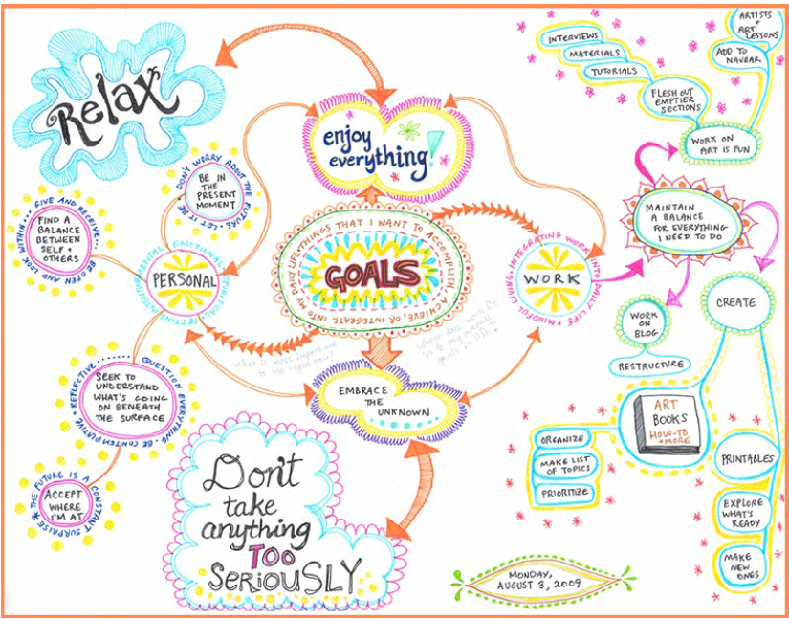
Concept map - example 2
From Art is fun!

Slide 12
Further learning resources on concept maps
AKO Aotearoa (Youtube video 9 mins)
Agriculture concept map for developing writing skills
Mindmeister (Webpage 7 mins read)
Why mind mapping? 5 key benefits (+ templates)
Bubble.us (Sign up for a free account)
An online app to create mind maps

Slide 13
Venn diagrams
Venn diagrams use overlapping circles to show what is similar and different between two or more groups.
The middle (overlapping) part shows what is shared, while the outer parts show what is unique to each group.
Venn diagrams make it easier to see how things are alike and different.
They help compare and contrast ideas or groups in a clear way.
They are useful for organising information and understanding relationships between ideas.

Slide 14
Venn diagram - example
Exploring the similarities and differences between fish and mammals
Mammals
Warm-blooded
Birth live young
Have hair or fur
Breathe with lungs
Fish
Cold-blooded
Lay eggs
Scaly skin
Breathe with gills
An internal skeleton and backbone

Slide 15
Fishbone diagrams
A fishbone diagram helps identify causes of a problem by organising them visually.
It looks like a fish skeleton, with the "head" showing the main problem and "bones" showing different causes.
Each "bone" represents a category of causes, like people, process, or materials.
It helps break down complex problems into smaller parts, making it easier to understand.
Fishbone diagrams are useful for brainstorming possible causes and finding solutions.

Slide 16
Fishbone diagram - example
Analysing the problem of low student engagement
Teaching methods
Materials
Activities not interactive
Too much lecture style
Not enough discussion
Lack of variety
Outdated and not relevant
Limited visual and multimedia
Don’t match learners’ interests
Not enough applied examples
Classroom environment
Student factors
Difficult to do group work
Room is noisy
Too many distractions
Lighting is not good
Little prior knowledge
Varying levels of English
Low interest in topics
Personal issues

