Slide 1
Join a Community of Practice
This resource supports the development of level 1, stage 3 core capabilities.

Slide 2
Contents
Introduction
What is a Community of Practice?
Being part of a CoP
Tips for a successful CoP

Slide 3
Introduction
A Community of Practice (CoP) is a group of people, who:
have a shared professional interest
come together to support one another to learn about their profession.
For us, this means a group of TVET practitioners who get together to develop their skills and knowledge related to TVET.
Joining a CoP is a way to:
learn new things
become a better TVET practitioner
connect with other professionals
be a part of a team where everyone is equal.
A CoP can be face-to-face or online.

Slide 4
What is a Community of Practice?

Slide 5
Other names for a Community of Practice
You may have heard of some other names for Community of Practice (or CoP for short)
It might be called a:
Professional group
Professional circle
Professional community
Learning network

Slide 6
CoP meetings
CoP members meet regularly and talk about their shared interest.
In TVET, members will all be interested in training for workplace competencies.
In the meetings, members discuss:
challenges and looking for solutions
sharing resources
reflecting on practice
celebrating success stories.

Slide 7
Benefits of a CoP
Check in on your practice
Encourage good practice
Support change
Belong to a team
Innovate
Learn from experience
The group can help you to check if you are heading in the right direction with your teaching.
The group can work together to create a common good practice for everyone to agree to and follow.
Making changes for your industry may be hard on your own but, a group has a lot more power.
The group will give you a sense of belonging and being part of a team. Working as a team means that you can work together on common problems to find solutions.
As a group, you can keep finding new and better ways to do things.
The group can learn from each other’s experiences by sharing stories.

Slide 8
Being part of a CoP

Slide 9
Feeling alone
As a trainer, you may feel alone and isolated at times.
Your learners expect you to have the answer to everything.
Sometimes, you might feel like you don’t have much support, or that you are expected to ‘sink or swim’.
Sometimes managers think this is a good way for you to learn, but not having support can be very stressful and make it hard for you to stay motivated to work.

Slide 10
Support network
Example
Emin has a tricky situation with a learner, who is struggling to learn. He feels that he has tried everything, but the learner just doesn’t seem to understand.
Emin discussed the issue in his CoP. The other members:
shared some stories about similar situations, so Emin didn’t feel so alone with the problem
brainstormed some new ideas and activities that Emin hadn’t tried before, so he learned some new training strategies.
Being a part of a CoP can give you a strong support network.
When you feel supported, you will feel more motivated and confident in your practice.
If you are confident, it means that your learners will trust you.
You have ‘credibility’, when your learners trust that you know your topic and you know how to train.

Slide 11
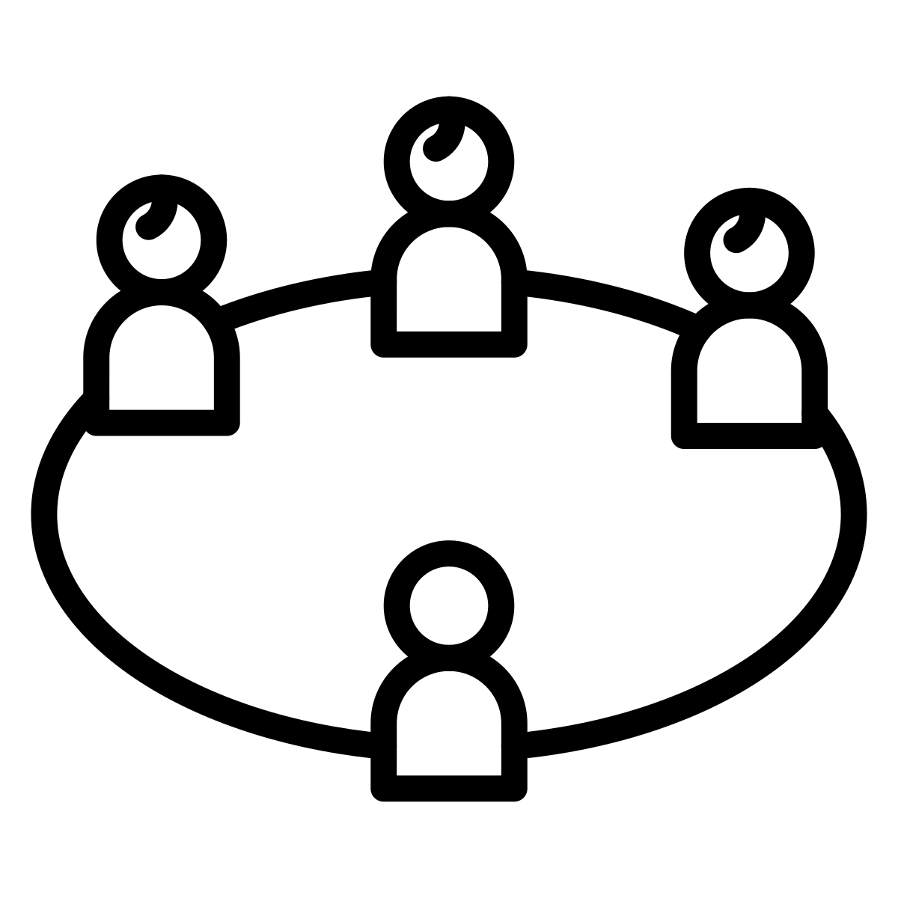
Experiential learning
Example
Emin was not confident to use some of the suggested strategies with his learners. The CoP members suggest he could do a practice session with them.
He prepared the session and delivered it to some of the CoP members. They:
gave him feedback
supported him as he reflected on the experience.
He left feeling confident, motivated, and supported.
Being part of a CoP give you an opportunity to learn and develop as a trainer.
The approach used in the example is called ‘experiential learning’.
Learning through experience
Try this approach with your learners.

Slide 12
Sharing knowledge & resources
Sharing knowledge
Sharing resources
A CoP contains a broad range of knowledge and skills.
Your knowledge and skills are a part of this, and you will share this with other people.
Other members will also have new and different ideas and ways of doing things.
It is useful to share things that didn’t work as well as things to did work.
Often trainers don’t have the resources they need or the money to buy them.
In a CoP members can share resources that they have developed or adapted.
Sharing experiences about how to work successfully with industry and community partners is another useful way to overcome resource shortages.
Sharing resources can save a lot of time and effort.

Slide 13
7 Tips for a successful Community of Practice

Slide 14
TIP 1: Clarify who the CoP is for
A CoP works best if the members all share the same type of job.
It is important that group members feel safe in the group so they can talk freely about things they find difficult, try new ideas, and make mistakes.
A trainer may feel uncomfortable to share if their manager is in the group.
A manager may feel uncomfortable to share if a regulator is in the group.
In TVET we can have a separate CoP for these different types of roles:
trainers, teachers, tutors
regulators and policy makers
managers, heads of school, deans.

Slide 15
TIP 2: Establish key roles
These roles can be done by one or more people.
They can also rotate between members over time.
Organiser
Facilitator
CoPs work better when someone takes responsibility for the following tasks:
arrange the time and date for meetings
find a room
send out calendar invitations
manage group communication
ask for topics and activities for the agenda
Meetings work well when there is a facilitator. They make sure:
discussions stay on track
the items on the agenda are covered
action points and ideas for the next meeting are written down.

Slide 16
TIP 3: Meet regularly
It is important that members commit time to establish the CoP.
Setting a regular meeting time from the outset will help people to commit to attending and building a positive group.
Suggestion:
start the CoP by meeting once a week
move to every second week or once a month, as the group matures.
Members need to feel safe to ask questions and discuss their challenges.
So, they need to get to know each other as soon as possible.
help everyone to feel comfortable
build trust within the group
Members want to feel that meetings are ‘good value’.
Good attendance and participation are important to develop ‘good value’.

Slide 17
TIP 4: Share stories
Establish the CoP so members are comfortable interacting with each other.
Encourage members to show respect by:
sharing stories
listening to other people’s stories
having an open mind.
Sharing stories can help people to:
make connections
learn
build trust
support each other.
Make sure to share stories of success as well as challenges.
Yes, I know what you mean. That happened to me too.”

Slide 18
TIP 5: Network
If you find like-minded people in the group, connect with them.
You don’t have to wait for the next meeting to talk to them.
Forming networks outside of meetings could help you in your job.
People from your CoP may also introduce you to other people who could help you.

Slide 19
TIP 6: Use a mix of activities
Share stories
Share stories of your challenges.
Activities
Include some activities or techniques for the group to try out.
Showcase
Someone in the group could share something that they are working on.
Invite other experts
You could invite an expert to talk about a topic.
Ideas for resources
Invite a local business or community representative to talk to the group about working together and sharing resources.
Recognition
Recognise members of the group for doing well.
For example, you could invite an expert on literacy and numeracy. This could give you some ideas to deal with challenges.
This could be for contributing to the group or trying something in their teaching that was a success.
It might give others in the group some ideas.
This could be something you could try with your own learners.
Make sure you share stories of your successes as well as challenges.

Slide 20
TIP 7: If it works, do more
It will take time for the group to take off.
It might feel challenging but keep going.
Try different things.
See what works and what doesn’t.
If you find something that works well in the meeting, then do more of it!

Slide 21
Activity Invite some colleagues to meet and brainstorm how you could form a CoP.

