Slide 1
Write good learning resources
This resource supports the development of level 1, stage 1 design capabilities.

Slide 2
Contents
Introduction
5 key principles for good learning resources
Clear, concise and accurate
Relevant to the learner
Easy to understand
The information has a logical order
It is designed with the learners in mind
Example

Slide 3
Introduction
This document will help you learn to create good learning resources.
Read this document before you start planning a learning resource. Then, review it as you are developing the resource.
You can use this document as a checklist to make sure you have applied the key principles.

Slide 4
5 key principles for good learning resources

Slide 5
Clear, concise and accurate
Principle 1
The purpose of the learning resource is clear.
The content relates to the learning outcomes.
Information is up-to-date and relevant to the topic.
Critical information is highlighted or made obvious to the learner.
The learning resource is reviewed and checked for accuracy by subject matter experts.

Slide 6
Relevant to the learner
Principle 2
The learners’ skills, knowledge and experience are considered.
Real workplace examples are used to help learners connect their learning to their own roles or situations.

Slide 7
Easy to understand
Principle 3
Instructions are clear and use simple language.
The content supports learners to understand concepts and integrate them into their roles.
Technical terms and acronyms are explained and used appropriately.
Graphics are used to compliment learners’ understanding.
See the resource Communicate Clearly in the TVET Toolkit.

Slide 8
Information has logical order
Principle 4
The learning resource is well-structured and appropriate for its purpose.
Similar content is grouped together.
The content is displayed in a logical order that allows the learner to understand the process.

Slide 9
Designed with the learners in mind
Principle 5
Learners’ needs and existing knowledge are considered
Their learning environment
Their literacy and numeracy skills
Their digital literacy skills
Their existing vocational knowledge and skills
Their life experience.
Relevant activities are included to reinforce learning.

Slide 10
Example
The following slides show a learning resource about electrical subcircuits.
It uses screenshots from the MS Word version.
To access this example in an accessible format, refer to the MS Word version. You can access the MS Word version from the TVET Toolkit.

Slide 11
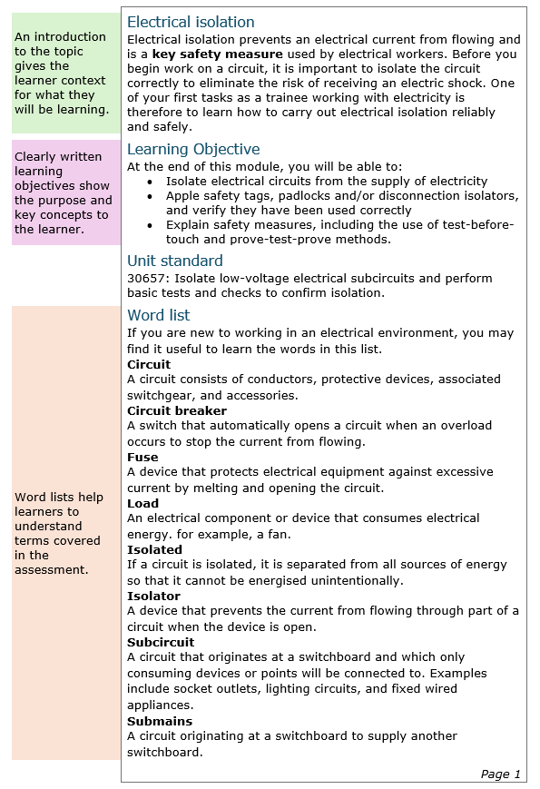
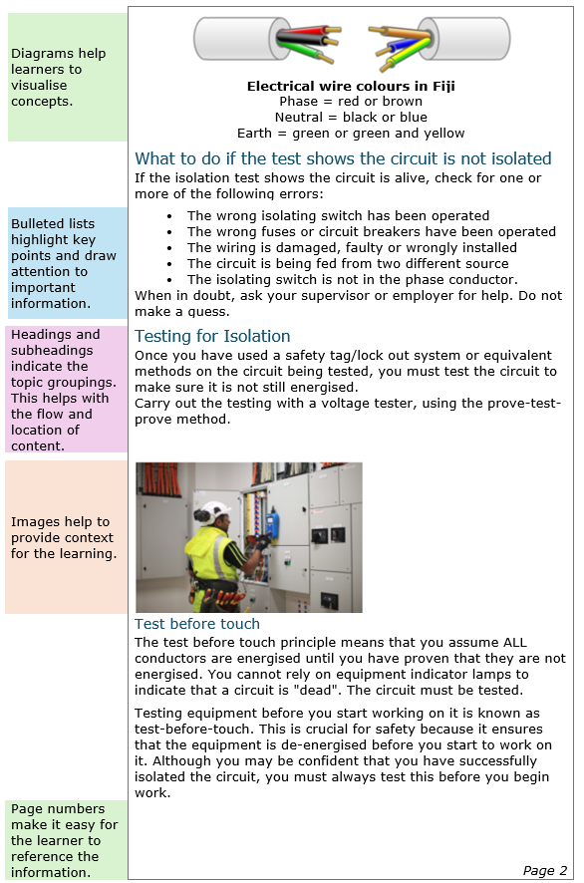
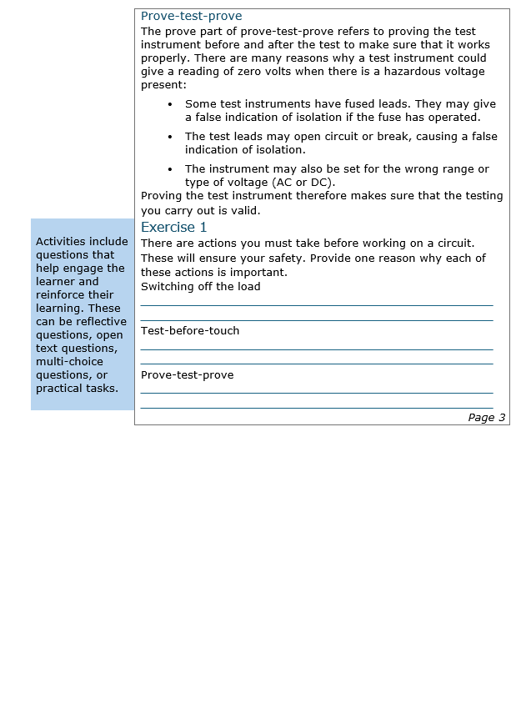
The example resource has 3 pages

Slide 12
An introduction provides context
Electrical isolation Electrical isolation prevents an electrical current from flowing and is a key safety measure used by electrical workers. Before you begin work on a circuit, it is important to isolate the circuit correctly to eliminate the risk of receiving an electric shock. One of your first tasks as a trainee working with electricity is therefore to learn how to carry out electrical isolation reliably and safely.
Page 1

Slide 13
Clearly written learning objectives explain the purpose and key concepts
Learning Objective At the end of this module, you will be able to: Isolate electrical circuits from the supply of electricity Apple safety tags, padlocks and/or disconnection isolators, and verify they have been used correctly Explain safety measures, including the use of test-before-touch and prove-test-prove methods.
Unit standard 30657: Isolate low-voltage electrical subcircuits and perform basic tests and checks to confirm isolation.

Slide 14
Headings and subheadings help with the flow and location of content
Electrical isolation Electrical isolation prevents an electrical current from flowing and is a key safety measure used by electrical workers. Before you begin work on a circuit, it is important to isolate the circuit correctly to eliminate the risk of receiving an electric shock. One of your first tasks as a trainee working with electricity is therefore to learn how to carry out electrical isolation reliably and safely.
Learning Objective At the end of this module, you will be able to: Isolate electrical circuits from the supply of electricity Apple safety tags, padlocks and/or disconnection isolators, and verify they have been used correctly Explain safety measures, including the use of test-before-touch and prove-test-prove methods.

Slide 15
Word lists help learners to understand unfamiliar terms
Word list If you are new to working in an electrical environment, you may find it useful to learn the words in this list. Circuit A circuit consists of conductors, protective devices, associated switchgear, and accessories. Circuit breaker A switch that automatically opens a circuit when an overload occurs to stop the current from flowing. Fuse A device that protects electrical equipment against excessive current by melting and opening the circuit. Load An electrical component or device that consumes electrical energy. for example, a fan. Isolated If a circuit is isolated, it is separated from all sources of energy

Slide 16
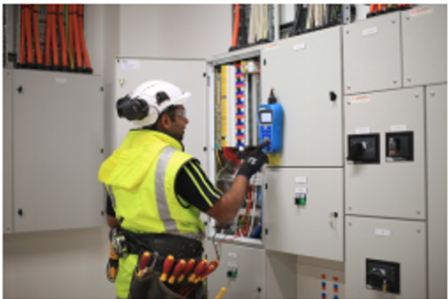
Images and diagrams help learners to visualise concepts and provide context for the learning
Electrical wire colours in New Zealand Phase = red or brown Neutral = black or blue Earth = green or green and yellow

Slide 17
Page numbers make it easy for the learner to reference the information
Page 2

Slide 18
Bullet lists highlight key points and draw attention to important information
What to do if the test shows the circuit is not isolated If the isolation test shows the circuit is alive, check for one or more of the following errors: The wrong isolating switch has been operated. The wrong fuses or circuit breakers have been operated. The wiring is damaged, faulty or wrongly installed. The circuit is being fed from two different sources. The isolating switch is not in the phase conductor. When in doubt, ask your supervisor or employer for help. Guesswork is a very bad idea when working with electricity!

Slide 19
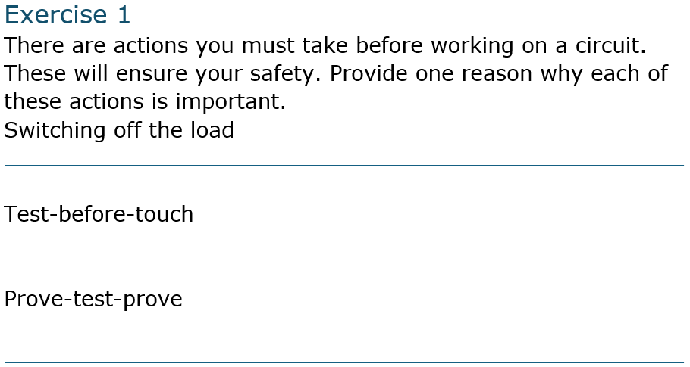
Activities help learners engage and reinforce their learning
Activities can include reflective questions, open text questions, multi-choice questions, or practical tasks.

