Slide 1
Put Read Aloud on your toolbar in MS Word
Level 1 Stage 1 Core

Slide 2
Contents
Introduction
Steps to add the icon to your toolbar
Control Read Aloud

Slide 3
Introduction
Read Aloud is a feature of Microsoft Word.
It can read the text in an open document to you.
You need to have Microsoft Word installed on your device.
It does not work if you use Microsoft Word 365 online.
You need to have headphones or speakers to listen.

Slide 4
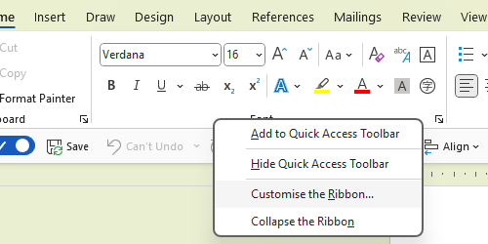
Step 1
Right click over a grey space on the toolbar
Click ‘Customise the Ribbon…’

Slide 5
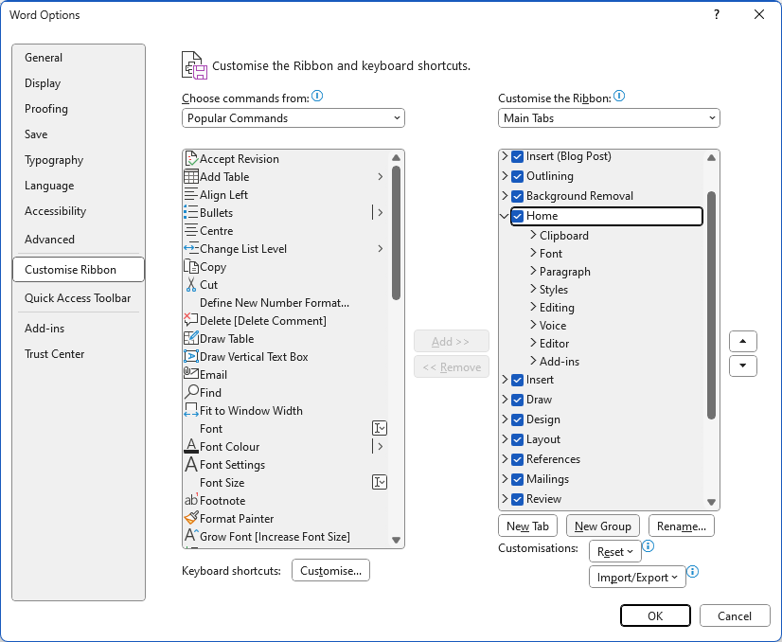
Step 2
Click ‘Home’
Click the ‘New Group’ button
Rename your group
Click Rename …
Type in a new name ‘Reading’

Slide 6
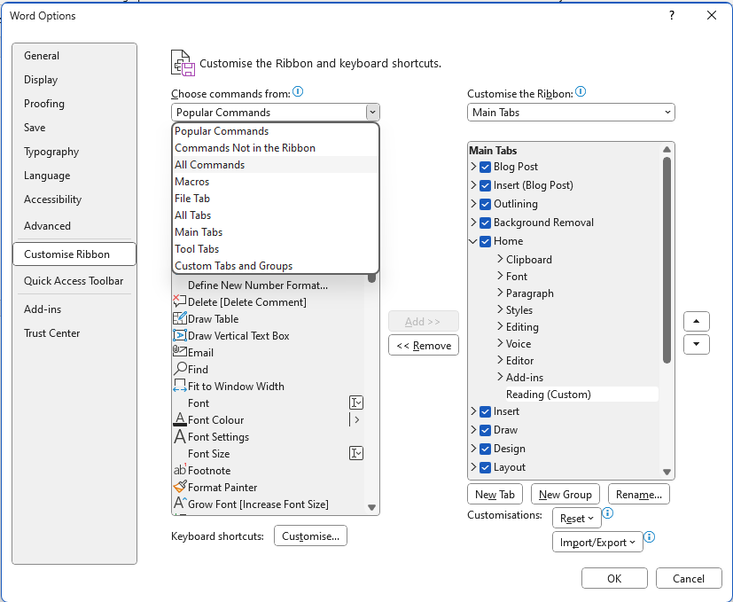
Step 3
Click on ‘Popular Commands’
Then click ‘All Commands’ in the drop-down menu

Slide 7
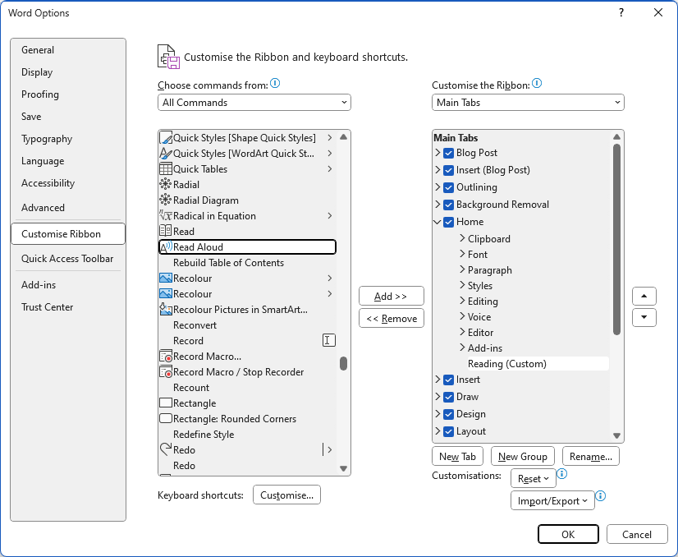
Step 4
Scroll down to ‘Read Aloud’ and click
It’s a way down, so don’t give up
Make sure your Reading group is highlighted
Click the ‘Add’ button
You’ll see the Read Aloud icon appear under your new group
Click OK

Slide 8
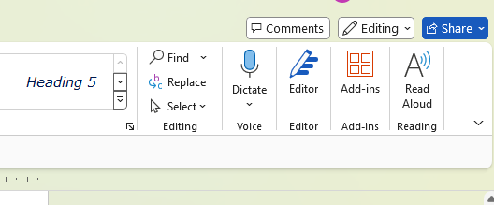
Step 5
You will now find a new button on your Home toolbar
Open a document and click the button to start listening

Slide 9
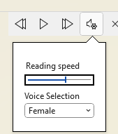
Controlling Read Aloud
When you have installed Read Aloud, you can control it from the toolbar in the top right corner of your window. This will appear after you click the Read Aloud button.
Click the setting icon to choose:
the reading speed you like
the voice you prefer

Slide 10
Finish
Now you can listen to Microsoft Word documents, as you read along.

